Slide 1
Prototype Cherenkov Detector
Presented by: Ryan Lorek
Hardware built, assembled, and assessed by:
Dane Pittock
Emily Shelton
Logan Smith
Abbott Veldhuizen
(And many more undergraduates)

Slide 2
Purpose of Prototype Cherenkov Detector
An array of ground based Cherenkov detectors can reconstruct the energy and direction of high energy cosmic rays from the photons produced in their interactions in the upper atmosphere.
Using a large number of Cherenkov detectors can serve as a check on the timing information necessary to reconstruct the incoming angle of the cosmic ray showers.
A large array of Cherenkov detectors can supplement data being gathered by florescence detectors while remaining comparatively cheaper than the florescence detector on a per unit basis.

Slide 3
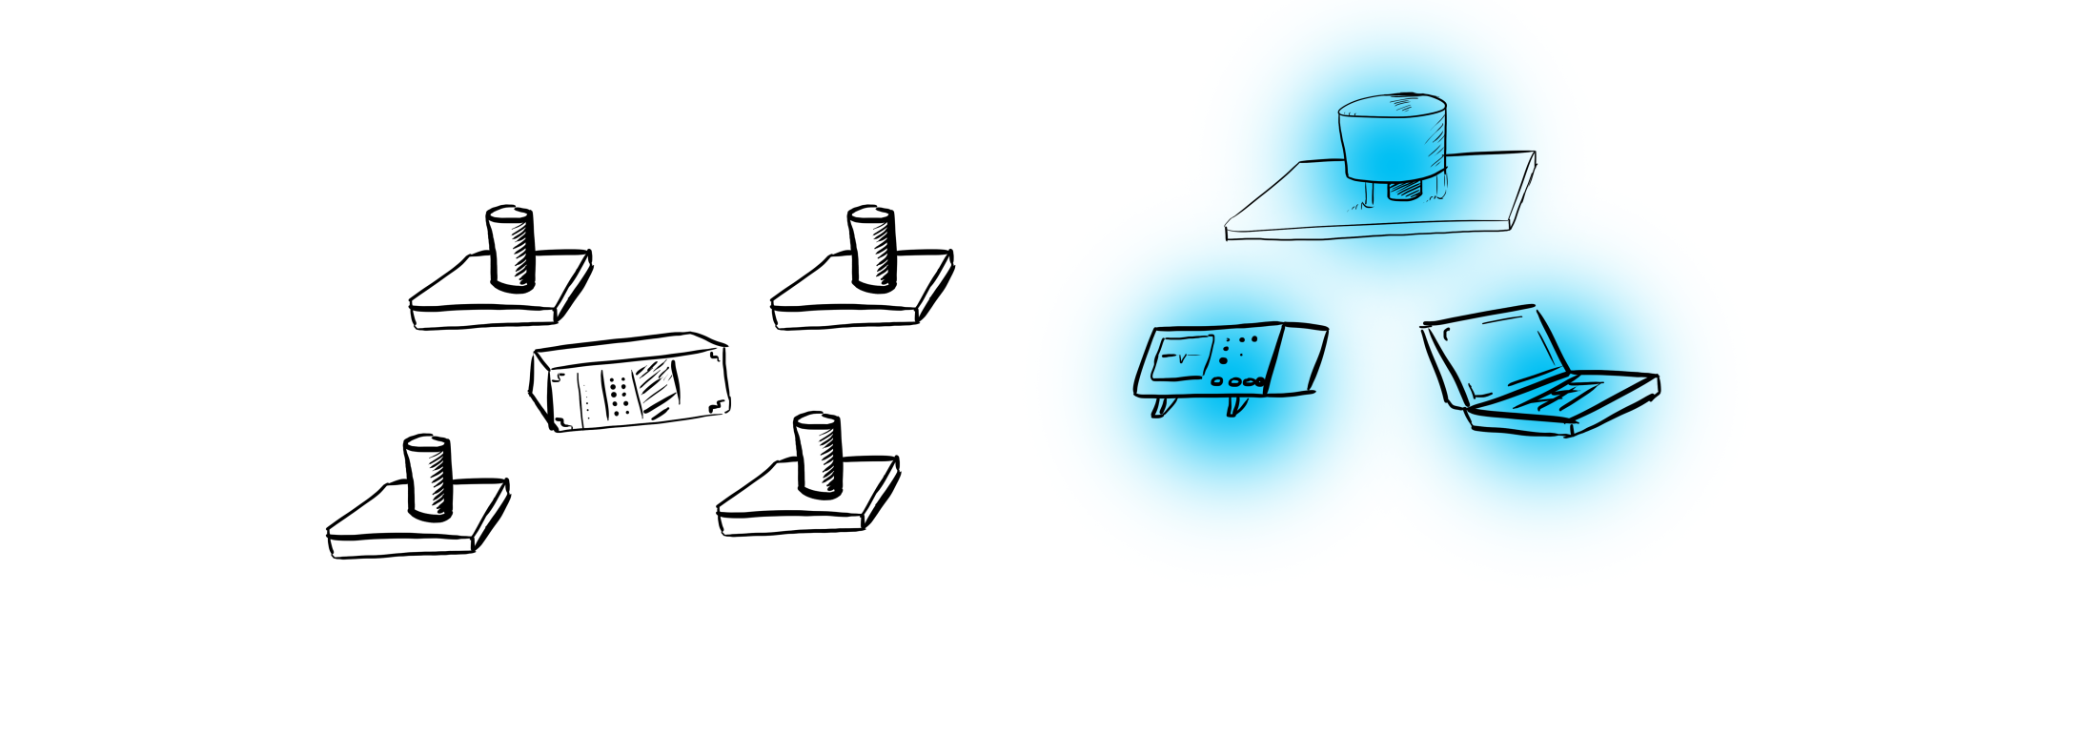
Concept of Detector Operation
Cherenkov Detecting PMT nestled in a Light cone constantly monitors the night sky.
Information is recorded on DAQ computer through an oscilloscope.

Slide 4
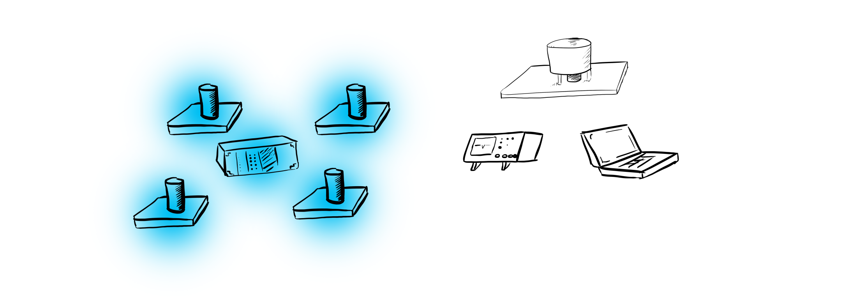
Concept of Detector Operation
Scintillator Panels Detect a Particle Shower.
This acts as a trigger for the DAQ.

Slide 5
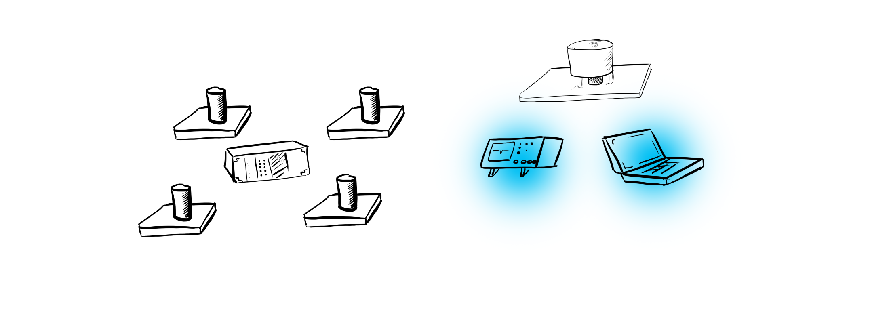
Concept of Detector Operation
DAQ computer looks back in time from trigger to attempt to identify a pulse that would be characteristic of Cherenkov light that correlates to the trigger.

Slide 6
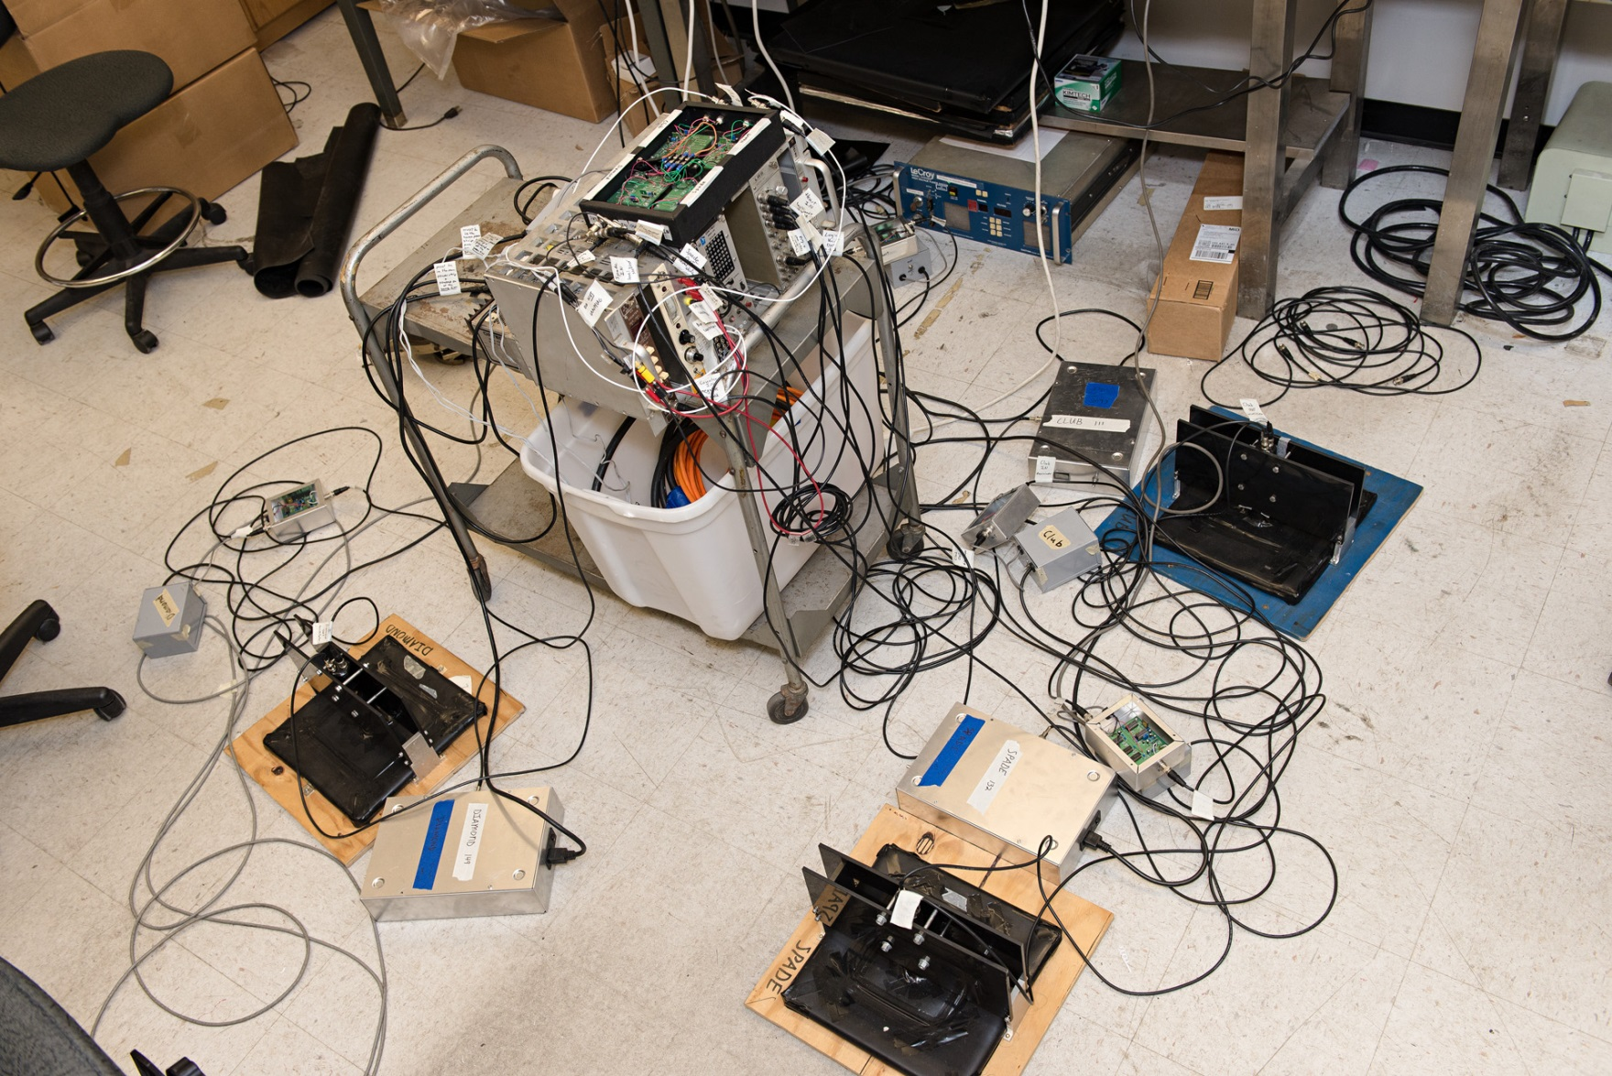
Scintillation Trigger Detector

Slide 7
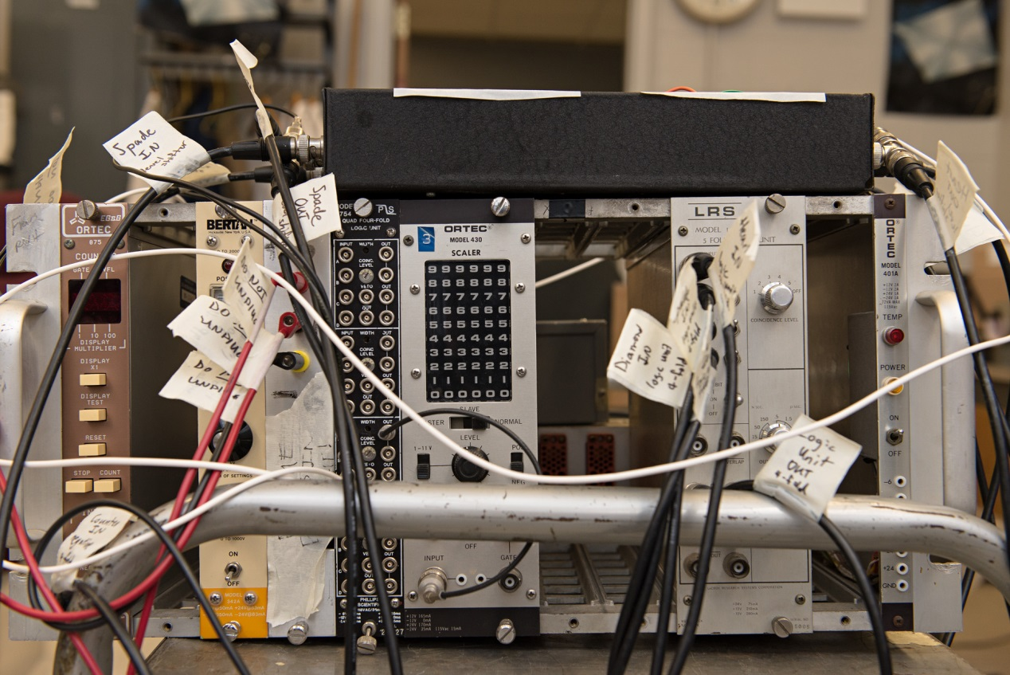
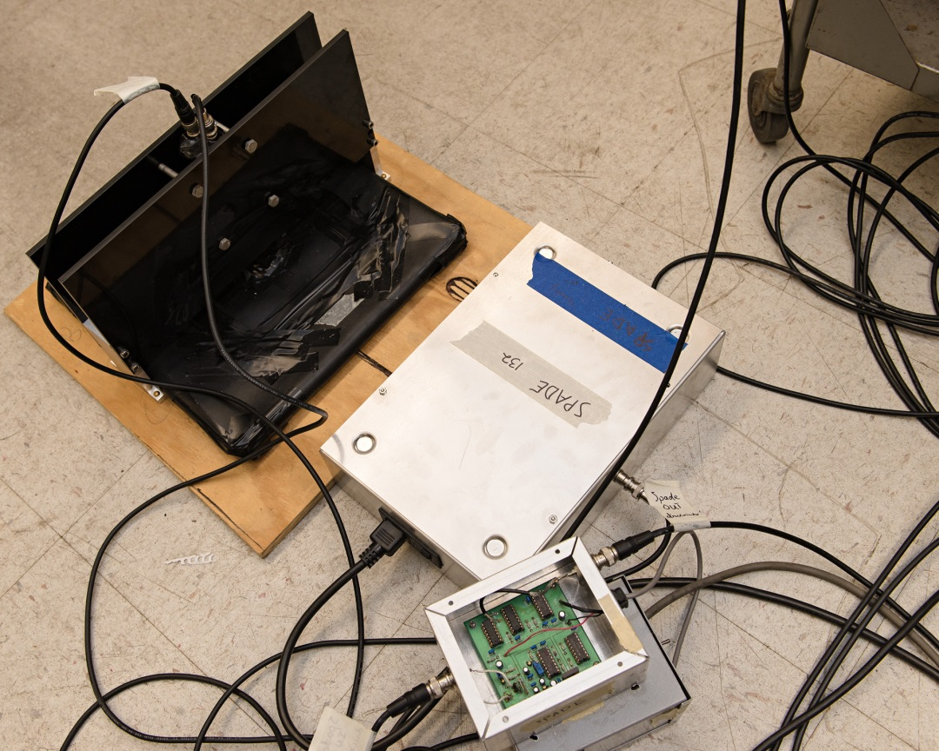
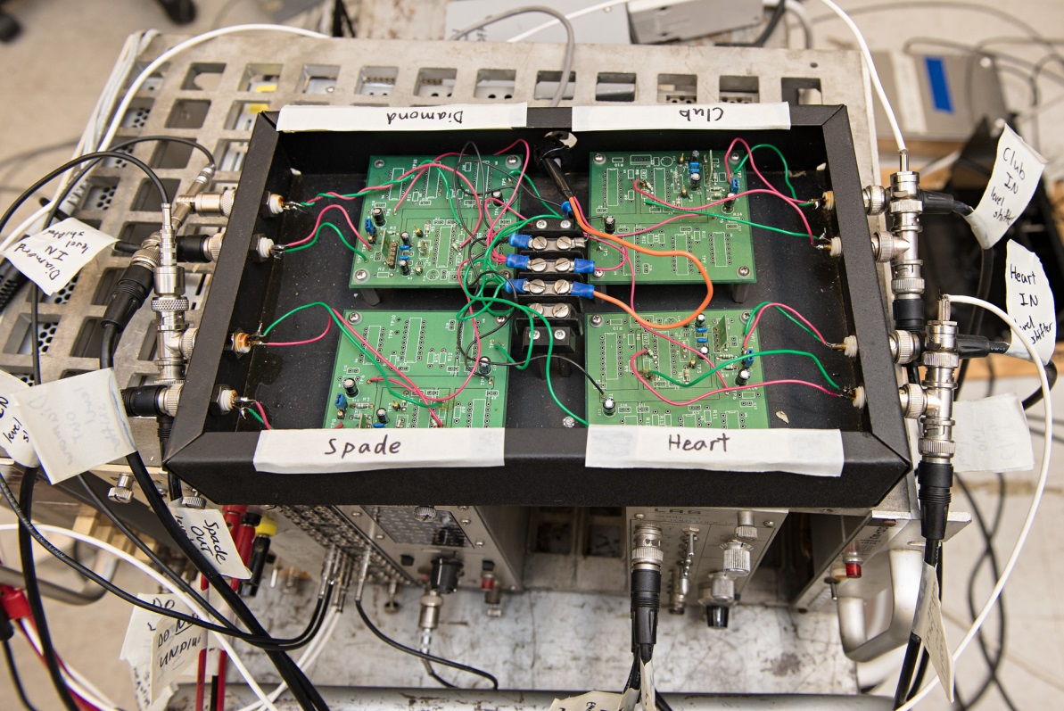
NIM logic rack
Level Shifter
Individual detector panel
and Threshold Discriminator

Slide 8
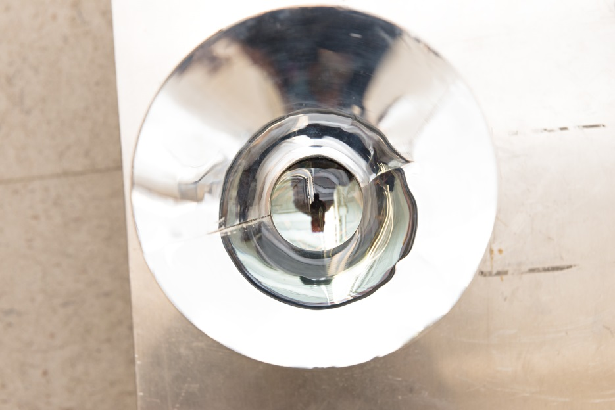
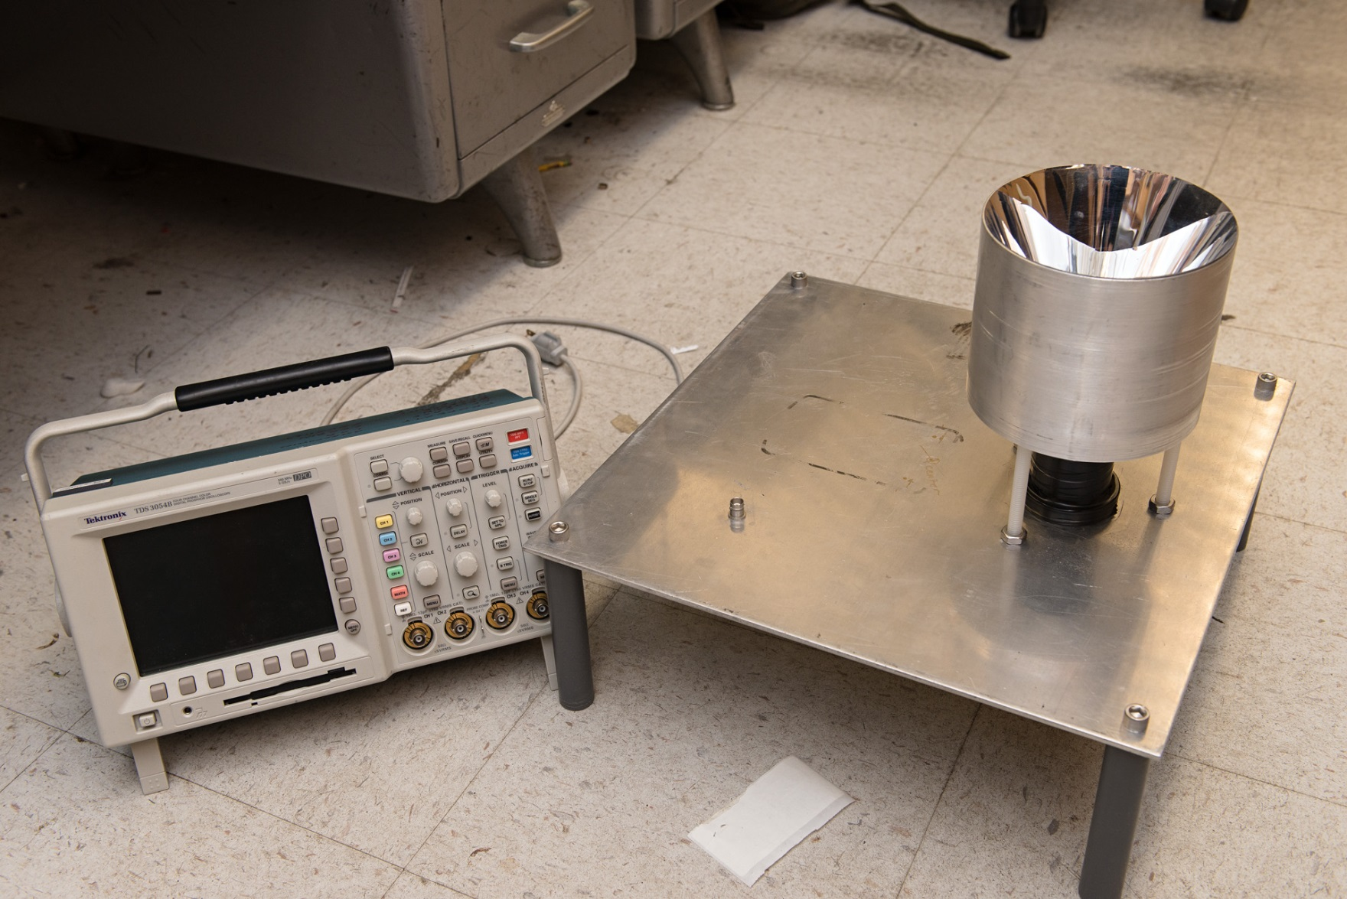
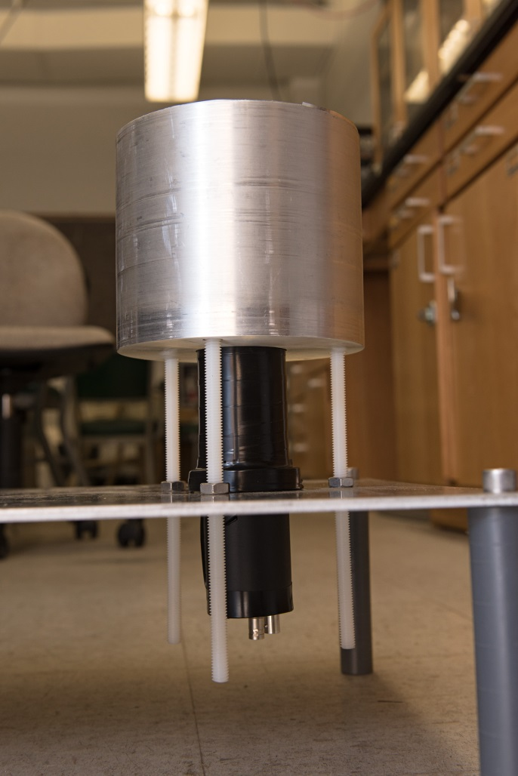
Cherenkov Detecting PMT and Light Cone

Slide 9
Questions?

